Slide 1
Movie Ratings prediction
Nicholas amoscato, Julie de Lorenzo and chun ping ng

Slide 2
Overview

Slide 3

Why predict movie ratings?
Theoretically you could predict the success of an arbitrary movie prior to its production
You can prevent big failures at the box office and give the films with the most potential the best financing

Slide 4

Okay, money. Why else?
It also allows for a better understanding of what draws us in to a film or turns us away
We can identify the unifying features of the stories we connect to most

Slide 5
Related work: Augustine, Pathak, u. texas
Achal Augustine and Manas Pathak from U. Texas explored the relationship between a film’s quality and a subset of the individuals involved
Looking at 1100 movies from 1995-2006 they had a test error of 9.983 %

Slide 6
Related work : Armstrong, yoon CMU
Nick Armstrong and Kevin Yoon from CMU looked at the relationship between a movie’s average rating on IMDB and some of the film’s attributes
They used Sequential Forward Search to narrow the features and then applied the kernel regression and linear model tree models
They achieved 14.11 % (kernel regression) and 14.40 % (model tree) deviation from the true rating

Slide 7
Related work: Steven haar, s. Illinois u.
Haar also used IMDB data but limited it to feature-length films from the US, a subset of 44,000 films
He applied to this subset multivariate linear regression as well as artificial neural network
Neural network 42 % better than control, linear regression 38 %
Concluded that neural network was superior for this type of calculation because it wasn’t limited to a linear model

Slide 8
Our choice of models
Model Tree: can take nominal inputs (as many movie features are) and produce continuous output
Neural Network: able to extract complicated trends and patterns that escape human observation

Slide 9
approach

Slide 10
Preprocessing

Slide 11
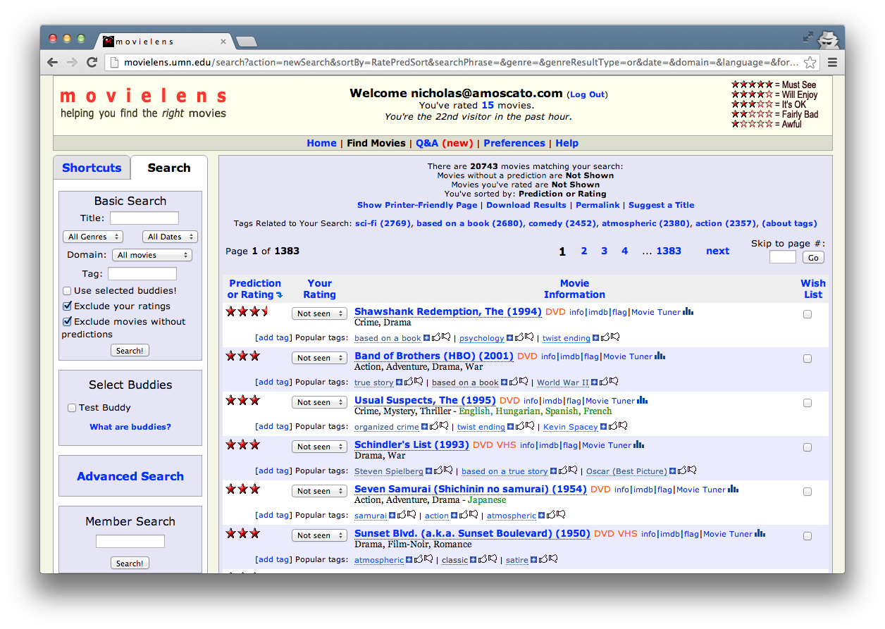

Slide 12
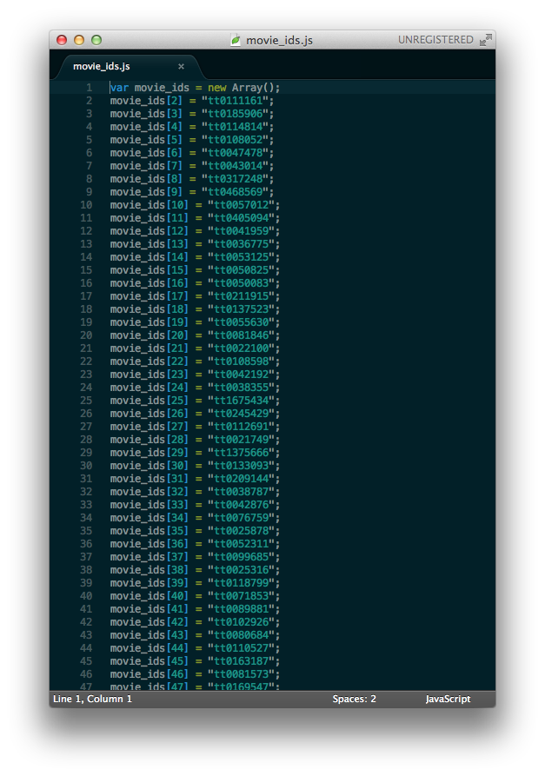
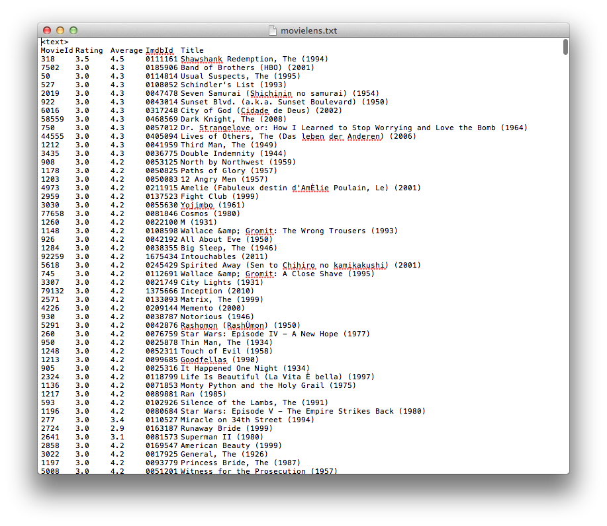

Slide 13


Slide 14
Feature selection

Slide 15

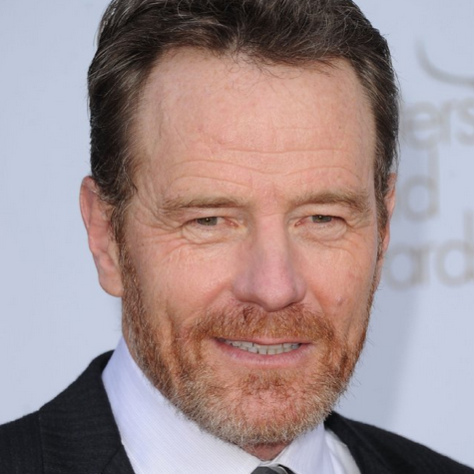

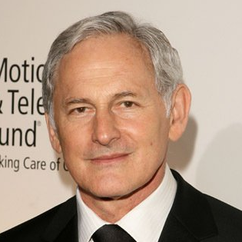
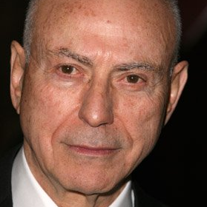
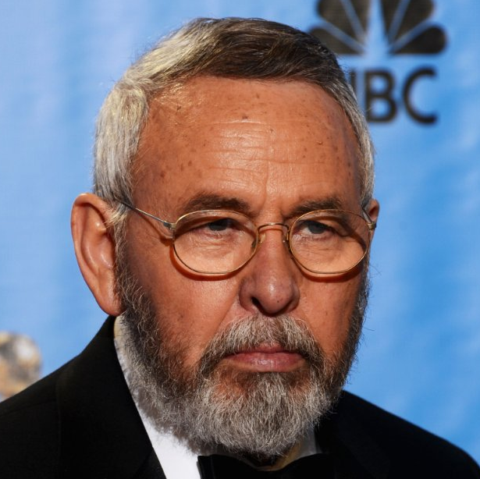

Cast Directors Writers Genres Language Country MPAA Rating Release Year Weekend Runtime
Drama, history Thriller
English, Persian
USA
R
2012
YES
120 min

Slide 16
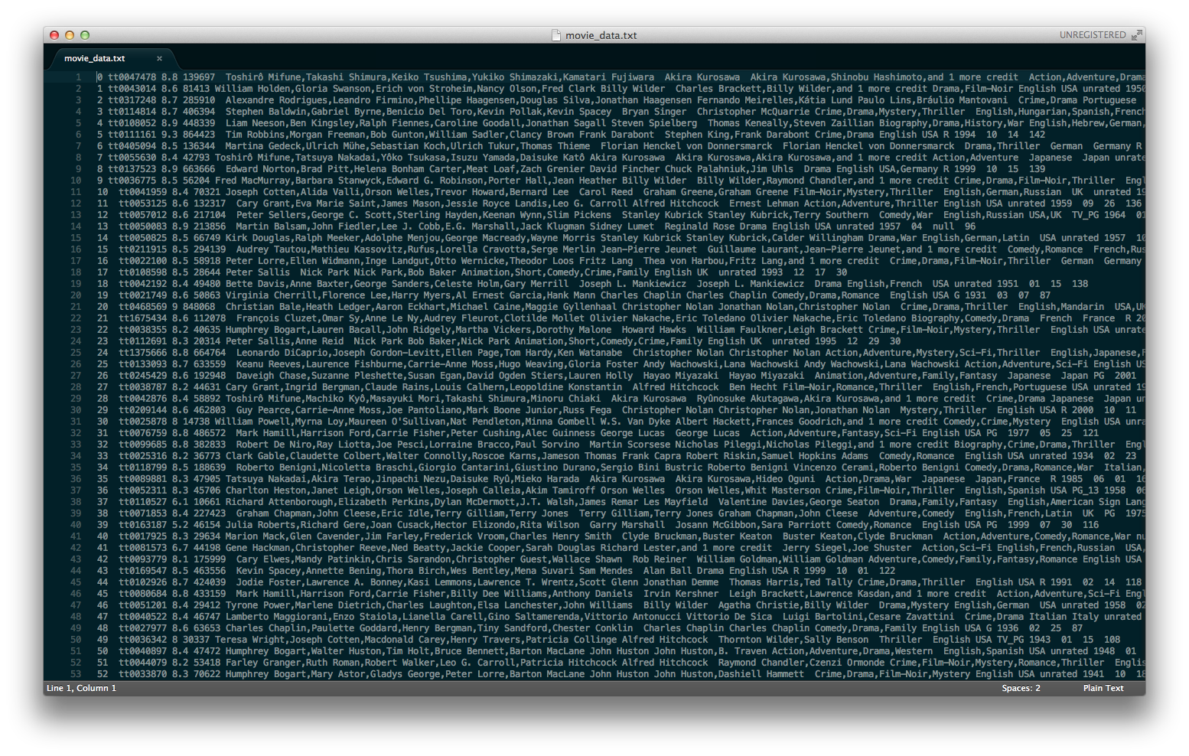


Slide 19
CLEAN DATA
REPLACED-MISSING DATA
11,889 Examples
17,240 Examples

Slide 20
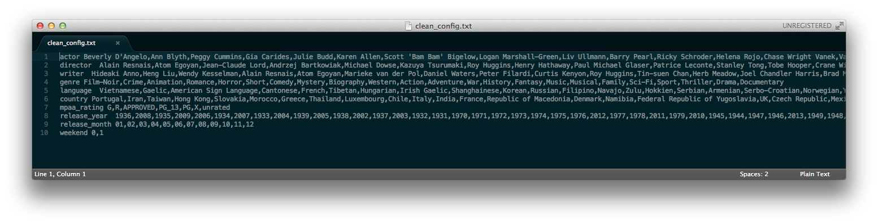
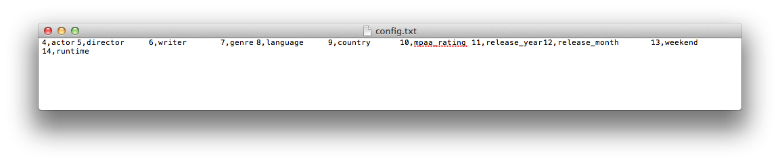
MODEL TREE CONFIGURATION

